Slide 1
My Perimeter, Area and Volume Interactive Notebook
Name
Class
Term 3 Semester 2

Slide 2
Contents
Formula Page
Page
Date
Description
2
3

Slide 3
Tasks
24
7
30
Essential Question
Questions
Notes
Summary
10
11

Slide 4

24
7
30
Date
Area
EQ – How do I use formulas to find the area of a shape?
Converting Units
x1000 ² x 100 ² x10 ²
km ² m ² cm ² mm ²
$÷$1000 ² $÷$100 ² $÷$10 ²
11

Slide 5
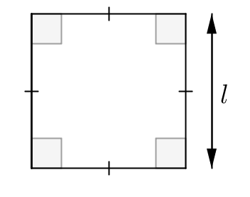
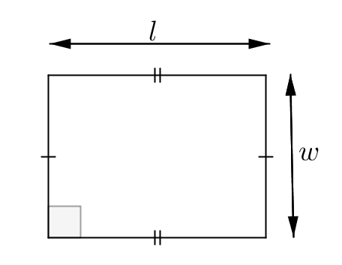
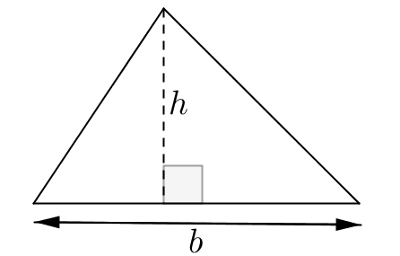
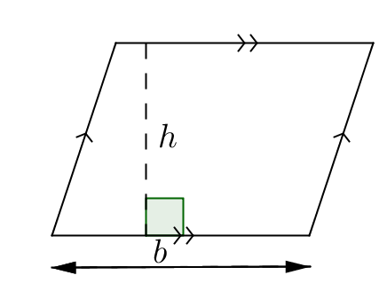
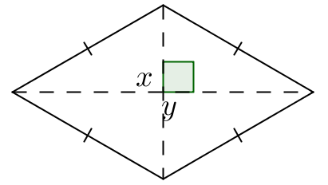
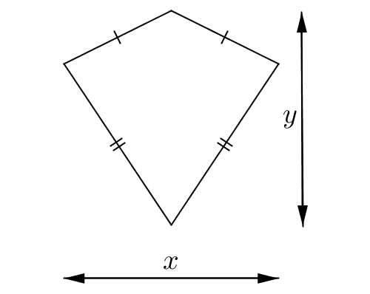
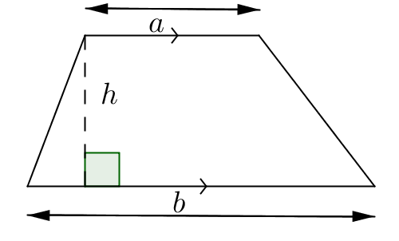
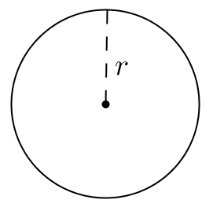
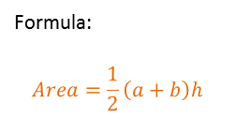
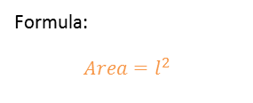
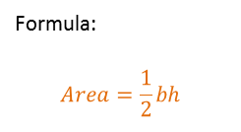
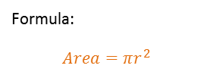
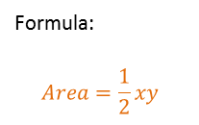
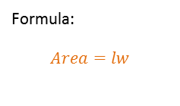
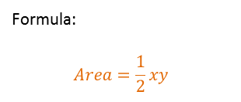
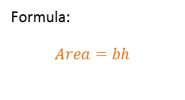
24
7
30
Date
Area
EQ – How do I use formulas to find the area of a shape?
Substitute the values into the formulas
Formula:
$$Area=l^{2}$$
Formula:
$$Area=lw$$
Formula:
$$Area=\frac{1}{2}bh$$
Formula:
$$Area=bh$$
Formula:
$$Area=\frac{1}{2}xy$$
Formula:
$$Area=\frac{1}{2}xy$$
Formula:
$$Area=\frac{1}{2}\left(a+b\right)h$$
Formula:
$$Area=πr^{2}$$
11

Slide 6
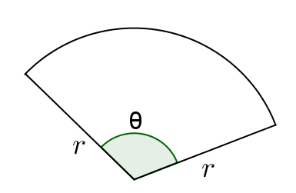
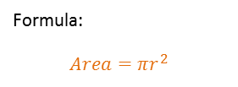


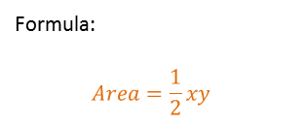
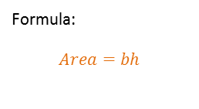
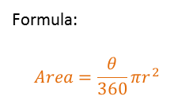
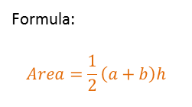
24
7
30
Date
Area
EQ – How do I use formulas to find the area of a shape?
Formula:
$$Area=\frac{1}{2}bh$$
Formula:
$$Area=bh$$
Formula:
$$Area=\frac{1}{2}xy$$
Formula:
$$Area=\frac{1}{2}xy$$
Formula:
$$Area=\frac{1}{2}\left(a+b\right)h$$
Formula:
$$Area=πr^{2}$$
Formula:
$$Area=\frac{θ}{360}πr^{2}$$
11

Slide 7
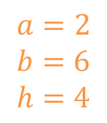


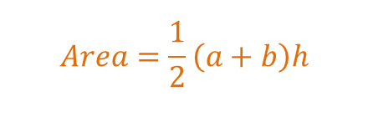

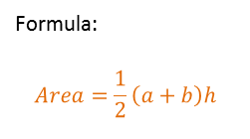

24
7
30
Date
Area
EQ – How do I use formulas to find the area of a shape?
Formula:
$$Area=\frac{1}{2}xy$$
Formula:
$$Area=\frac{1}{2}xy$$
Formula:
$$Area=\frac{1}{2}\left(a+b\right)h$$
Formula:
$$Area=πr^{2}$$
Formula:
$$Area=\frac{θ}{360}πr^{2}$$
E.g.
2m
$$Area=\frac{1}{2}\left(a+b\right)h$$
$$a=2$$
$$b=6$$
$$h=4$$
4m
6m
11

Slide 8
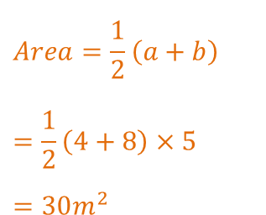
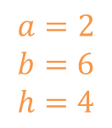
24
7
30
Date
Area
EQ – How do I use formulas to find the area of a shape?
Formula:
$$Area=\frac{1}{2}xy$$
Formula:
$$Area=\frac{1}{2}xy$$
Formula:
$$Area=\frac{1}{2}\left(a+b\right)h$$
Formula:
$$Area=πr^{2}$$
Formula:
$$Area=\frac{θ}{360}πr^{2}$$
E.g.
$$Area=\frac{1}{2}\left(a+b\right)$$
$$=\frac{1}{2}\left(4+8\right)×5$$
$$=30m^{2}$$
$$a=2$$
$$b=6$$
$$h=4$$
2m
4m
6m
11

Slide 9
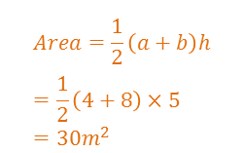
24
7
30
Date
Area
EQ – How do I use formulas to find the area of a shape?
Formula:
$$Area=\frac{1}{2}xy$$
Formula:
$$Area=\frac{1}{2}xy$$
Formula:
$$Area=\frac{1}{2}\left(a+b\right)h$$
Formula:
$$Area=πr^{2}$$
Formula:
$$Area=\frac{θ}{360}πr^{2}$$
E.g.
$$Area=\frac{1}{2}\left(a+b\right)h=\frac{1}{2}\left(4+8\right)×5=30m^{2}$$
11

Slide 10
Questions

Slide 11
24
7
30
Date
Area
EQ – How do I use formulas to find the area of a shape?
Converting Units
How do I convert units for area?
x1000 ² x 100 ² x10 ²
km ² m ² cm ² mm ²
$÷$1000 ² $÷$100 ² $÷$10 ²
11

Slide 12
24
7
30
Date
Area
EQ – How do I use formulas to find the area of a shape?
What are the formulas for the basic shapes?
Formula:
$$Area=\frac{1}{2}xy$$
Formula:
$$Area=\frac{1}{2}xy$$
Formula:
$$Area=\frac{1}{2}\left(a+b\right)h$$
Formula:
$$Area=πr^{2}$$
Formula:
$$Area=\frac{θ}{360}πr^{2}$$
How do I use a formula?
E.g.
$$Area=\frac{1}{2}\left(a+b\right)h=\frac{1}{2}\left(4+8\right)×5=30m^{2}$$
11

Slide 13
Notes Review
24, 7 ,30
Date
Title
Essential question
Notes complete
Notes complete with colour and diagrams
Questions completed
Contents page filed in
Formula page filled in

Slide 14
Homework
Review your notes and write a summary answering the essential question.

Slide 15
Plenary
Draw three shapes with a perimeter of 36cm.

